Slide 1

SCA: A Secure CNN Accelerator for Both Training and Inference
Lei Zhao, Youtao Zhang, Jun Yang
University of Pittsburgh

Slide 2

About ME
My name is Lei Zhao.
PhD candidate in the University of Pittsburgh.
Research areas:
Computer architecture.
Domain specific accelerator design.
Secure and privacy-preserving machine learning.

Slide 3






Neural Networks are widely used in mobile devices
Speech recognition
Facial recognition
Navigation
Health care
Translation
…

Slide 4






Models need to be protected
Encryption
Extract the model
CPU
Memory
Retrain with custom data on device
Decryption
Encryption
Storage

Slide 5
Background
Design
Methodology
Results
Conclusion
Motivation
Use stochastic computing for cheaper computation
Use SC precision loss as hardware fingerprint for protection
Weights are stored in binary
format off-chip
Weights are stored in SC
format on-chip
0.65
0.12, 0.44 …, -0.5
… … … …
0.55, -0.44 …, 1.34
0.11, 0.47 …, -0.48
… … … …
0.57, -0.42 …, 1.35
0.58
W_{b}
W_{sc}
Low accuracy if used in CNN prediction
Can produce accuracy prediction

Slide 6
Background
Design
Methodology
Results
Conclusion
Stochastic Computing
SC Numbers are represented by the probability of 1s in a bit stream
E.g., : X = 0.75 = 0.110_{b} = 1001111011011111_{sc}
Binary format
SC format
Use simple logic to implement addition and multiplication
Addition
Multiplication
A_{sc}
A_{sc}
MUX
C_{sc}
C_{sc}
B_{sc}
XNOR
B_{sc}
0.5

Slide 7
Background
Design
Methodology
Results
Conclusion
eDRAM
Cell structure
abstract
Need refresh operation to restore value
‘0’ bit
‘1’ bit
Leak charge
refresh

Slide 8
Background
Design
Methodology
Results
Conclusion
SC based Protection
Generating device dependent bit streams
Victim row
…
❶ Fully charge a row of cells
❷ Reduce refresh frequency
1 0 0 1 0 1 0
❸ Read out
❹ Conversion
P(X=1)≈0.5
P(X=1)<0.5
P(X=1)>0.5
00…0
11…1

Slide 9
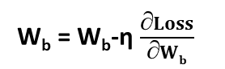
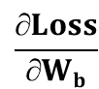
Background
Design
Methodology
Results
Conclusion
SC based Protection
Embedding device dependent information into NN models
Neural networks are over-parameterized
Forward propagate
using W_{sc} to get Loss
Convert weights from
binary to SC format:
W_{b} W_{sc}
Calculate derivative of Loss
over binary weights:
$$\frac{∂Loss}{∂Wb}$$
Update the binary weights:
W_{b} = W_{b}-η $\frac{∂Loss}{∂Wb}$

Slide 10
Background
Design
Methodology
Results
Conclusion
SC based Protection
The weights are training using device A’s memory to generate SC numbers
Target Device: Test using device A’s memory to generate SC numbers
Pirate Device: Test using another device B’s memory to generate SC numbers
No SC: Test using binary numbers directly
 | Target Device | Pirate Device | No SC
MNIST-MLPS | 99.73% | 57.98% | 60.25%
MNIST-MLPM | 99.69% | 21.57% | 24.75%
MNIST-MLPL | 99.99% | 22.99% | 26.38%
MNIST-CNN | 99.07% | 14.27% | 81.82%
SVHN-CNN | 99.84% | 69.04% | 60.9%
Cifar10-CNN | 99.99% | 41.86% | 53.44%

Slide 11
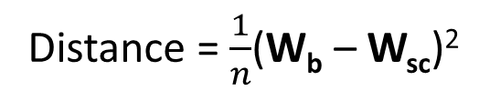
Background
Design
Methodology
Results
Conclusion
Secure Learning Phase
CNNs are capable to learn the difference between W_{b} and W_{sc}.
Distance = $\frac{1}{n}$(W_{b} – W_{sc})²
Solution
Change the offset to insert 1s and 0s.
Each epoch only changes one layer’s offset.
Epoch 1
00…0
Epoch 2
00…0
Epoch 3
00…0

Slide 12
Background
Design
Methodology
Results
Conclusion
Secure Learning Phase
Distance stops decreasing when training converges

Slide 13
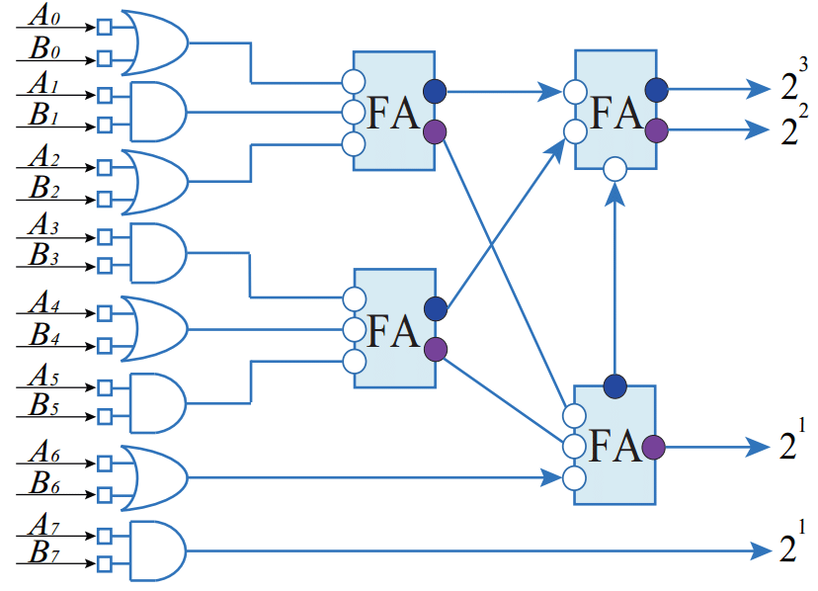
Background
Design
Methodology
Results
Conclusion
Optimized MAC Operation
MUX based adder
256
64
256
64
XNOR
256
XNOR
256
APC
1
MUX
1
1
0
Concat
Simple logic
Multiple cycles
Low precision
0
1
1
1
XNOR
1
0
MUX
1
0
1
1
XNOR
+
1
0
0
0
0
1
XNOR
…
XNOR
MUX
APC
Concat
XNOR
XNOR
…
+
APC based adder
XNOR
XNOR
MUX
APC
Concat
…
XNOR
High precision
More gates
Needs adders for subsequent operations
XNOR
+
XNOR
XNOR
MUX
APC
Adder tree
Concat
XNOR
XNOR
Group adder

Slide 14
Background
Design
Methodology
Results
Conclusion
Accelerator Overview
Off-chip
Mem
Controller
Weight Buffer
Local Weights
W_{b}
W_{b}
W_{sc}
MAC Unit
SCC Unit
W_{sc}
Input Buffer
+
Out_{b}
Local Inputs
In_{sc}
In_{b}
In_{b}
In_{sc}
Output Buffer
Local Outputs
Activation
Out_{b}
Out_{b}
Out_{b}
Pool
DRAM
eRAM
SRAM
Whenever data are stored in off-chip memory, they are in binary format, thus being protected

Slide 15
Background
Design
Methodology
Results
Conclusion
CNN framework
Accelerator characteristics
Custom CNN frame written in C++ with CUDA acceleration
Replace all computations in C++ and CUDA kernels with SC bit-wise operations
Benchmarks
MNIST-MLPS | 250-10
MNIST-MLPM | 500-250-10
MNIST-MLPL | 1000-500-250-10
MNIST-CNN | conv5x20-pool2-500-10
SVHN-CNN | conv5x32-pool2-conv5x64-pool2-256-10
Cifar10-CNN | conv4x32-pool2-conv5x32-pool2-conv5x64-pool-500-10
Schemes
AEP [ICCAD`2017] | Use dram soft error on binary format weights to protect CNN models
SC-CNN [DAC`2017] | SC accelerated CNN accelerator design
SCA-1 | SC based protection on CNN models
SCA-2 | SCA-1 with optimized MAC operation

Slide 16
Background
Design
Methodology
Results
Conclusion
Performance
4.8X
Normalized to APE.
SCA-1 achieves 11.7X speedup by using memory read based SC conversion.
SCA-2 further improves performance to 34.2X due to optimized MAC and shorter bit streams.

Slide 17
Background
Design
Methodology
Results
Conclusion
Energy
Normalized to APE.
SCA-1 consumes 94.4% less energy than SC-CNN by using DRAM read based SC conversion.
SCA-2 further reduces 98.6% energy compared to AEP.

Slide 18
Background
Design
Methodology
Results
Conclusion
Motivation
Mobile devices have a requirement for protection and fast computation.
Solution
Use SC for fast computation.
Use precision loss during SC conversion as hardware fingerprint.
Also support on device training.
Results
Prevents model to run (both training and inference) on unauthorized device.
Achieves 34.2X speedup.
Saves 98.6% energy.

Slide 19
Thanks for watching Questions

